Slide 1

MEDITATION GENERATOR
TEAM 3

Slide 2

TEAM MEMBERS
Pratham Priyank Thakkar
Chirag Jain
Keval Jain
Romica Raisinghani

Slide 3
MOTIVATION & PROBLEM STATEMENT
We worked for the Atom startup. Atom is a guided meditation app, which aims to provide personalized meditation based on behavioral scientific research.
To achieve this task of creating personalized mediations their CMS team used various small audio clips, i.e., snippets which are stitched by them using a tool(descript) to create the meditation.
Since this task of creating meditations in this fashion is slow and laborious, we were assigned to create a meditation generating tool to aid them.

Slide 4
TEMNINOLOGIES
Note: Since the project provided to us is domain specific, there are quite a few jargons, thus if you don't understand some term, please inquire to avoid any communication gaps between us.

Slide 5
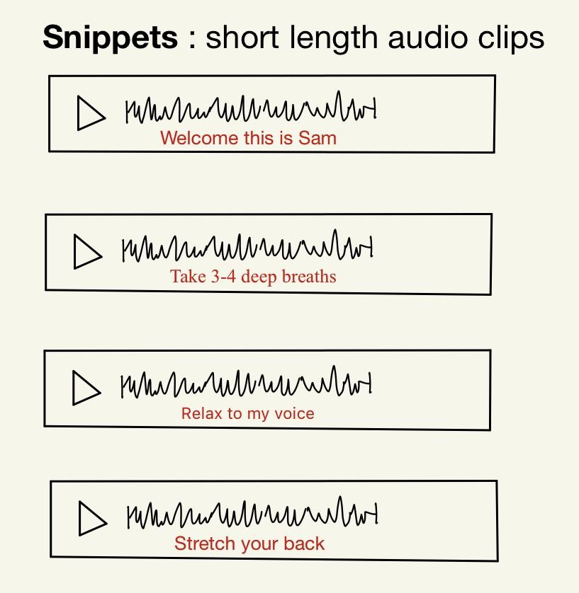
1. SNIPPETS
Snippets are small audio clips with some specific goal
For example: "Welcome this is Sam" is a snippet whose goal is to welcome the user.

Slide 6
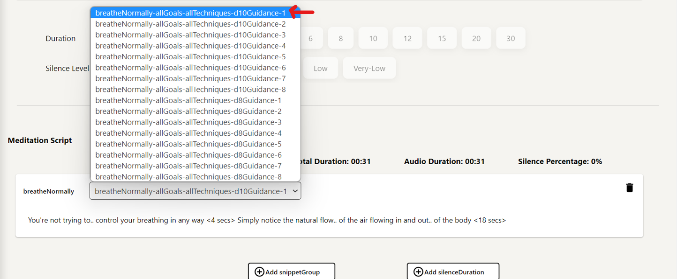
This is a snippet

Slide 7
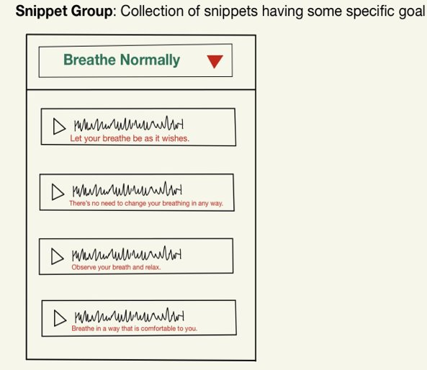
2. SNIPPET GROUP
A snippet group is a collection of snippets, that have same goal.
For example: All the snippets whose goal is to welcome the user are kept in the Welcome snippet group.

Slide 8
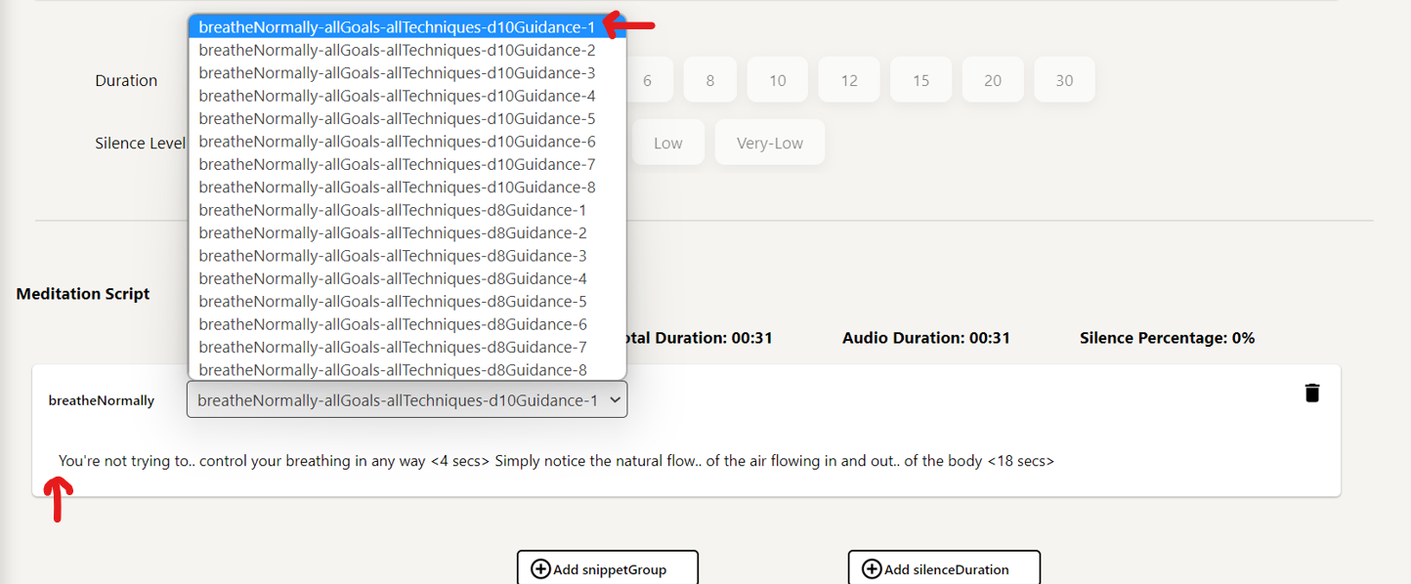
This is a snippet
This is a snippet group.

Slide 9
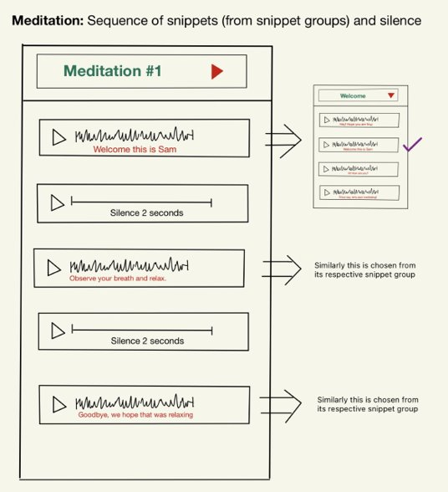
3. MEDITATION
A meditation is a collection of snippets and silence.
While creating a meditation instead of directly inserting snippets, the user inserts the snippet groups and picks any snippet of his choice from that snippet group.

Slide 10
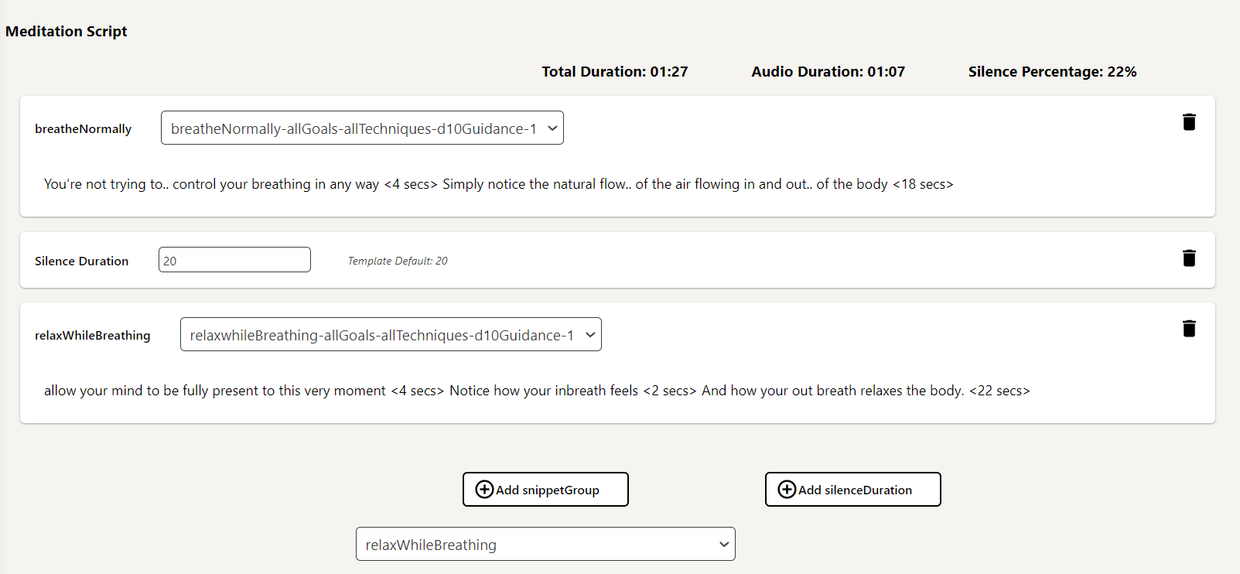
Meditation

Slide 11
TEMNINOLOGIES (continued)
4. Silence: These are audio clips with no voice in them.
5. Template:
Since constructing meditations in the manner described above is a repetitive job, we have the concept of a template, which serves as a blueprint for creating meditations.
A template is a collection of snippets and silence.
When generating a meditation, the user can select a template and inherit that template's structure in that meditation, making the work of producing meditations easier. (We will show this in the website demo)
6. Sub – Templates:
Furthermore, because multiple templates can have similar structure with just tiny differences in total silence or total duration, we have the idea of sub-templates, which is simply the template with a selected silence level and duration.

Slide 12
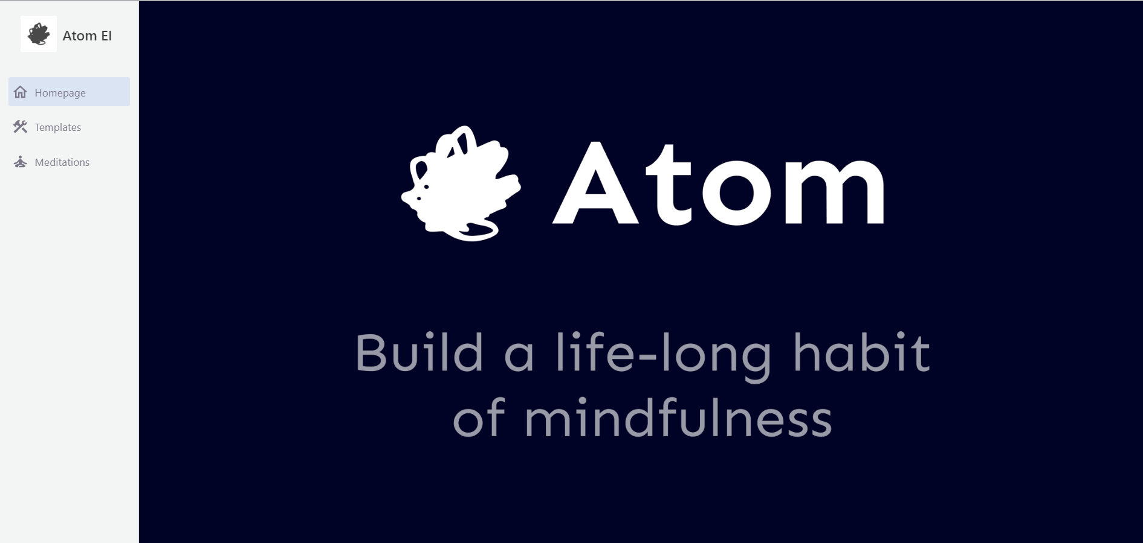
Site Demonstration

Slide 13
SCOPING – THE DEVELOPMENT TIMELINE
16 Jan. 2023
Allocation of team along with the project
20 Jan. 2023
First interaction with the client where we were briefed about the project requirements and provided with the schema on how the interface should look like and function.
27 Jan. 2023
Submitted the Project Concept Document v1 giving a clear description of the problem statement, feature highlights and the milestones to be delivered.
10 Feb. 2023
Worked on the Software Requirements Specification (SRS) document wherein we described the users profile that our project caters to as well as the project modules describing the backend and frontend functionalities.
11 Feb. 2023
A video walkthrough by the client explaining the functionalities to be delivered as a part of the project.

Slide 14
SCOPING – THE DEVELOPMENT TIMELINE
16 Feb. 2023
The Project Plan Document v1 was formed discussing the development environment that will be used for the project along with the milestone schedule mentioning the due dates and deliverables for each milestone.
20 Feb. 2023
Started working on the functionalities as per the requirements specified by the client.
23 Feb. 2023
Set up of the sprint-wise backlog on GitLab including Milestones, Sprints, Issues, and Labels indicative of the work being done for the project.
6 Mar. 2023
Had a doubt clearing session with the client and his associate to ensure smooth implementation of the project going forward.
10 Mar. 2023
Release 1 presentations demonstrating the work that has been done up till now.

Slide 15
SCOPING – THE DEVELOPMENT TIMELINE
16 Mar. 2023
AirTable structure proposed via document (by Shabinder)
24 Mar. 2023
Create/ Edit meditations page (by Samvid)
4 Apr. 2023
Client starting populating the AirTable to start testing functionalities
The Project Design Doc v1 was submitted that includes the system overview, design overview, user interface and sequence diagram providing more detailed technical information on the system's architecture and operation.
29 Mar. 2023
25 Mar. 2023
Added silence range and duration range functionalities (directed by Samvid)
27 Mar. 2023
Decided to remove the link between meditations and templates
31 Mar. 2023
Generate wav part (directed by Shabinder)

Slide 16
SCOPING – THE DEVELOPMENT TIMELINE
Release 2 presentations demonstrating the final product implemented.
14 Apr. 2023
Client meet (Sahil tester) + fixed loaded bug.
17 Apr. 2023
Meet with the tester to clear confusion and explain functionality + UX improvement suggestions (by Sahil).
18 Apr. 2023
Last client meet where the final product was showcased.
24 Apr. 2023
Updating the gitlab backlog covering the gitlab issues that have been completed and those that are still incomplete.
26 Apr. 2023
Template Copy functionality added + UI/UX change (change in opacity) + Worked on the Software Requirements Document (Version 2)
8 Apr. 2023

Slide 17

COMPLETED AND PENDING TASKS
Sprint 0
Completed tasks :
Introduction to the project.
Sprint 1
Completed tasks :
Finished project comprehension and scoping.
Sprint 2
Completed tasks :
Understood their existing codebase,.
Improved CSS of various containers and displayed snippet text.
The necessary frontend for generating randomized meditations based on a given template has been added.

Slide 18
COMPLETED AND PENDING TASKS
Sprint 3 and 4
Completed tasks :
Randomized feature was removed, and we proceeded further.​
Implemented the Templates Dashboard​.
Implemented the Create Template Functionality.​
Option to save, sync and delete the template were added.

Slide 19
COMPLETED AND PENDING TASKS
Sprint 5 and 6:
Completed tasks:
Sub-template functionality was added.​
Implemented the Meditation Dashboard
​Implemented the Create Meditation Functionality.​
Option to save, sync and delete the meditation were added.
​Download Meditation As Wav Functionality was added.

Slide 20
COMPLETED AND PENDING TASKS
Pending Tasks:
All the tasks given by the client were completed as of 19th April 2023 and there are no pending tasks left.

Slide 21
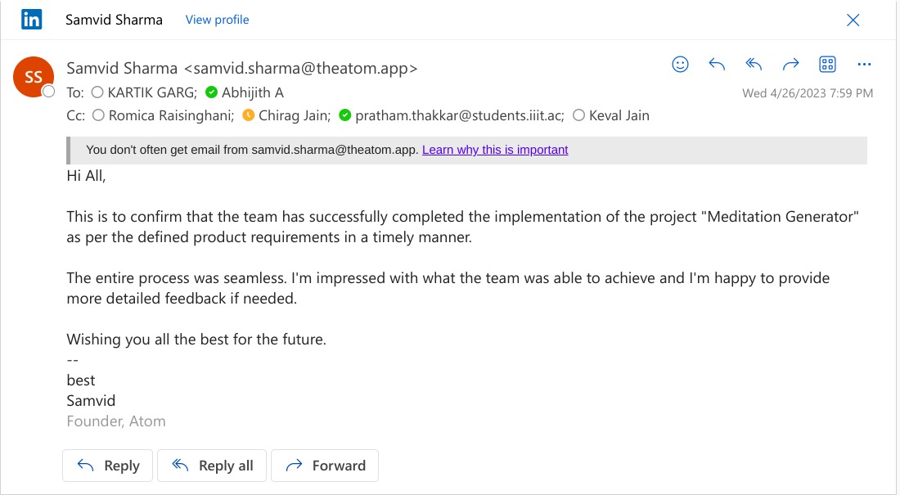
Client Feedback

Slide 22
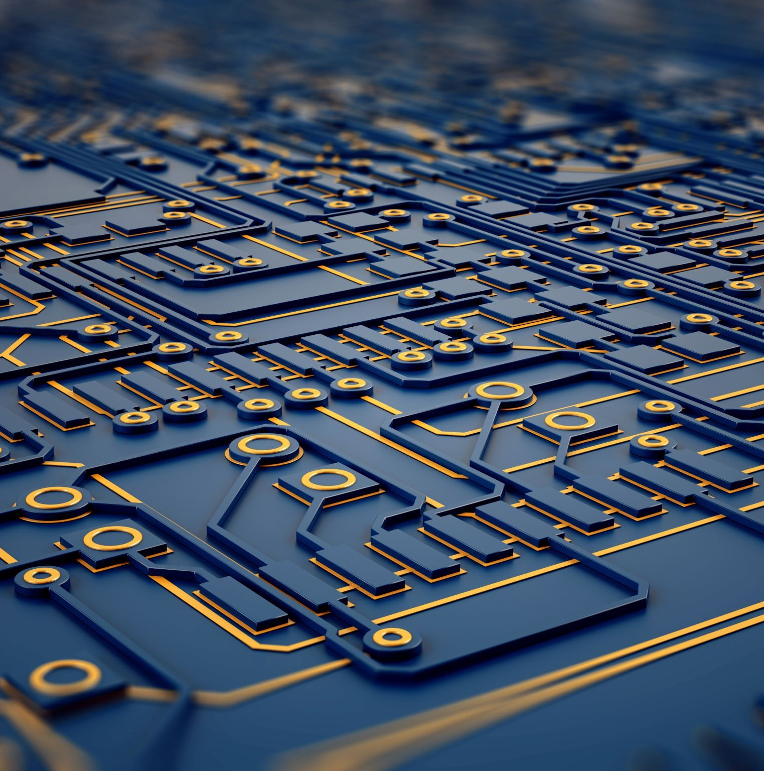
TECH STACK USED
1. Frontend is developed using :-
Typescript
ReactJS
HTML, CSS
2. Additional JavaScript libraries used :-
Styled-components: Styling library
Crunker: Audio manipulation and concatenation
Pino: Logging library
Mui Icons: Providing user-interface components
3. AirTable is used as Backend support for storing data and providing API calls to access it.

Slide 23
CHALLENGES FACED IN THE PROJECT
Since, the project was domain specific we initially had difficulty and confusion in understanding the client.
There was some trouble getting the feedback as at times the clients wasn’t responsive.
Their requirements were often changed by the client.
Difficulty with Airtable.

Slide 24
THANK YOU !

